Slide 1
ARRAYS AND STRINGS

Slide 2
Why do we need Arrays?
Consider a brand-new problem: A program that can print its input in reverse order. If there are two values, this is easy and the program is
#include <stdio.h>
int main()
{
int v1,v2;
printf(“Enter two values:”);
scanf(“%i %i”, &v1, &v2);
printf(“%i\n%i\n”, v2, v1);
return 0;
}
Similarly, if there are three values, that is still relatively easy .
But what if there are ten or twenty or one hundred values? Then it is not so easy….
Consider another problem: the average of n integer numbers given by the user can easily be computed . Now if the problem is given as ‘Print the numbers that are greater than the average, then one solution is to read the numbers twice which is not possible for larger values. To overcome this problem, an ARRAY is required

Slide 3
What are ARRAYS?
Array is the collection of homogeneous data items stored in contiguous memory location.
Under single variable declaration , we can store multiple datas.
All data must be of same datatype.
Eg: int rollno[60];
NOTE:
An array is a collection of individual data elements that is:
Ordered- one can count of the elements 0,1,2,3,..
Homogeneous – all elements have to be of the same type, e.g., int, float, char, etc.
Individual elements are identified by an integer index. In C , the index begins at zero and is
always written inside square brackets.
datatype
Size of the array
Name of the array

Slide 4
ARRAY DECLARATION
Syntax for Array Declaration:
data_type array_name [SIZE];
NOTE:
All the array elements hold values of type <data type>
The size of the array is indicated by <SIZE>, the number of elements in the array. <SIZE> must be an int constant or a constant expression.
EXAMPLE:
int a[10]; /* an array with 10 int elements */
This reserves space for 10 integers.
Once declared, an array element can be referenced as <array name>[<index>]
where <index> is an integer constant or variable ranging from 0 to <SIZE> - 1.
The elements for the array named ‘a’ can be accessed with a[0],a[1]….a[9].
a[0] refers to the first number stored in the ‘a’ array.
a[1] refers to the second number stored in the ‘a’ array.
a[9] refers to the tenth number stored in the ‘a’ array.

Slide 5

a[0] a[1] a[2] a[3] a[4]
a array
ARRAY INITIALISATION
Array initialisation can be done either at compile time or at run time.
COMPILE-TIME INITIALISATION
Compile-time initialization means that the array is initialized when the program is compiled. The values of the array elements are set in the source code itself, and these values are fixed and cannot be changed during the execution of the program. This method is typically used when the array values are known in advance and do not change.

Slide 6
EXAMPLES:
int a[5] = { 0, -1, 11, 10, 2}
int a[ ] = {0, 1, 2, 0, -1, 6, 7}
int a[5] = { 0,1,-1} → The remaining space will be initialised with ‘0’.
int a[5]; [ Array have any garbage value]
EXAMPLE FOR COMPILE TIME INITIALISATION
#include <stdio.h>
int main() {
// Compile-time initialization
int arr[5] = {1, 2, 3, 4, 5};
// Print the array elements
for(int i = 0; i < 5; i++) {
printf("%d ", arr[i]);
}
return 0;
}

Slide 7
INITIALISATION OF ARRAY AT RUN TIME
Run-time initialization means that the array is initialized during the execution of the program. This method is used when the values are not known at compile time and need to be computed or read from an external source (like user input, files, or network) during the program execution.
EXAMPLE:
#include <stdio.h>
int main() {
int arr[5];
// Run-time initialization
printf("Enter 5 integers:\n");
for(int i = 0; i < 5; i++) {
scanf("%d", &arr[i]);
}
// Print the array elements
for(int i = 0; i < 5; i++) {
printf("%d ", arr[i]);
}
return 0;
}

Slide 8
IMPORTANT POINTS TO BE REMEMBERED:
If the size of array is less, then compile time is enough.
If the size of array is large, run time initialisation is preferred.
Memory in arrays will be allocated in contiguous manner.
There is an INTERNAL POINTER present in all the arrays which stores the base address of the array.
Random access of data items of array is possible.
To know the address of an element in the array, use
Base address + ( index * size of int)
Once the size has declared, it can’t be changed at Run Time.
Index starts from 0.
Arrays can store data in multi-dimensional form.
Inserting and Deleting elements from array is costly.
There is no bound checking in C.

Slide 9
VALID DECLARATIONS OF ARRAY:
#include<stdio.h>
#define N 100
int main()
{
double x[N], y[N];
…
return 0;
}
The number of array elements can also be given by an expression
int x[N+1];
double y[M+5*N];
#include <stdio.h>
#define N 20
int main()
{
int i =1, j = 3, k=2;
float arr[N];
arr[0];
arr[3];
arr[9];
arr[i*j+k];
arr[N-10];
arr[N-1];
}

Slide 10
OTHER ALLOWED OPERATIONS FOR AN ARRAY NAMED ‘ar’:
To increment the i th element, the given statements can be used.
To add n to the i th element, the following statements may be used,
To copy the contents of the i th element to the k th element, the following statement may be written.
To copy the contents of one array ‘ar’ to another array ‘br’, it must again be done one by one.
ar[i] ++;
ar[i] += 1;
ar[i] = ar[i] + 1;
ar[i] += n;
ar[i] = ar[i] + n;
ar[k] = ar[i] ;
int ar[10], br[10];
for(i=0; i<10 ; i=i+1)
br[i] = ar[i]

Slide 11
To exchange the values in ar[i] and ar[k], a ‘temporary’ variable must be declared to hold one value, and it should be the same data type as the array elements being swaped. To perform this task, the following C statements are written.
STORING VALUES GIVEN BY THE USER IN AN ARRAY
Reading the input into an array is done as shown:
The idea is that first a value must be read and copied into a[0], then another value read and copied into a[1], and so on, until all the input values have been read.
int temp;
temp = ar[i] ; /* save a copy of value in ar[i] */
ar[i] = ar[j]; /* copy value from ar[j] to ar[i] */
ar[j] = temp; /* copy saved value of ar[i] to ar[j] */
int a[10]; /* an array with 10 “int” elements */
int i;
for(i=0 ; i<10; i++)
scanf(“%d”, &a[i]);

Slide 12
PRINTING AN ARRAY
The following code segment prints the elements of an array, a[10].
INVALID DECLARATIONS OF AN ARRAY:
for(i=0; i<10; i++)
printf(“%d”, a[i]);
#include <stdio.h>
int main()
{
double x[ ] , y[ ];
…
return 0;
}
#include <stdio.h>
int main()
{
int N;
double x[N], y[N];
…
scanf(“%d”, &N);
return 0;
}
C does not allow declaring an array whose number of elements is unknown at compile time. So the above declaration statement is not valid.
This kind of a declaration is illegal in C and results in compile-time error.

Slide 13
Consider an example,
#include <stdio.h>
void main()
{
int a[5], i;
for(i=0; i<5; i++)
{
scanf(“%d”, &a[i]);
}
for(i=0; i<5; i++)
{
printf(“%d”, a[i]);
}
}
0 1 2 3 4
15
100 104 108 112 116
a
100
Here, the internal pointer points to the first element of the array and stores it’s address.

Slide 14
Some basic programs in Arrays.
TO FIND THE SUM AND AVERAGE OF THE GIVEN ARRAY
#include <stdio.h>
void main()
{
int marks[5];
int sum=0 ,avg;
for(i=0; i<5; i++)
{
scanf (“%d”, &marks[i]);
}
for(i=0; i<5; i++)
{
sum=sum + marks[i];
}
avg = sum / 5;
printf (“%d”, avg);
}
OUTPUT:
6 7 8 9
7

Slide 15
PROGRAM TO READ AN ARRAY OF 10 INTEGERS AND COUNT TOTAL NUMBER OF EVEN AND ODD ELEMENTS:
#include<stdio.h>
void main( )
{
int a[10],i;
int even=0 , odd = 0;
for(i=0; i<10; i++)
{
scanf(“%d”,&a[i]);
}
for(i=0; i<10; i++)
{
if (a[i] % 2 == 0)
even = even + 1;
else
odd = odd + 1;
}
printf(“\n Even elements are = %d” , even);
printf(“\n Odd elements are = %d”, odd);
}
OUTPUT:
1 2 3 4 5 6 7 8 9 10
Even elements are = 5
Odd elements are = 5

Slide 16

PROGRAM TO READ ARRAYS OF SIZE 5 AND STORE THE SUM OF THESE ARRAYS INTO THAT ARRAY .
arr_1 =
arr_2=
sumarr =
#include <stdio.h>
void main( )
{
int arr 1[5], arr 2[5], sumarr[5];
int i;
for(i=0; i<5; i++)
scanf(“%d”, &arr 1[i] );
for(i=0; i<5; i++)
scanf(“%d”, &arr 2[i] );
for(i=0 ; i<5; i++)
{
sumarr[i] = arr 1[i] + arr 2[i];
printf(“Sum of elements at index %d : %d\n” ,i, sumarr[i]);
}
}
OUTPUT:
5 4 2 3 5
6 7 8 9 10
Sum of elements at index 0 : 11
Sum of elements at index 1 : 11
Sum of elements at index 2 : 10
Sum of elements at index 3 : 12
Sum of elements at index 4 : 15

Slide 17
MULTIDIMENSIONAL ARRAYS:
Arrays with more than one dimension are called multidimensional arrays.
DECLARATION OF A TWO-DIMENSIONAL ARRAY:
data_type array_name[size1][size2];
data_type is the name of some type of data, such as int.
size1 and size2 are the sizes of the array’s first and second dimensions. In general, the size1 can be considered as the row size and size2 can be considered as the column size.
Eg: int marks[5][60];
This example can be considered in a way such that, the marks of the 60 students in 5 subjects.
Two-Dimensional arrays can be initialised in two ways:
At Compile-Time
At Run-Time

Slide 18
Consider these examples of array initialisation done at COMPILE-TIME:
int a[2][3] = {{0,0,0},{1,1,1}};
1st row 2nd row
int a[ ][3] = {{0,0,0} , {1,1,1}};
int a[2][3] = {0,0,1,1} ;
int a[ ][3] = {0}; Here, only one row will be there.
RUN-TIME INITIALISATION:
0 1 2
ROW 0
ROW 1
0 | 0 | 1
1 | 0 | 0
#include<stdio.h>
void main( )
{
int a[2][3];
for(i=0; i<2; i++)
{
for(j=0; j<3; j++)
{
scanf(“%d”,&a[i][j]);
}
}
}
Remaining are filled with zeroes

Slide 19
SOME IMPORTANT BASIC PROGRAMS:
PROGRAM TO PRINT 2-D ARRAY AND CALCULATE THE SUM:
#include <stdio.h>
void main( )
{
int a[2][3], i , j, sum=0;
for(i=0; i<2; i++){
for(j=0; j<3; j++){
scanf(“%d”,&a[i][j]);
}
}
for(i=0; i<2; i++) {
for(j=0; j<3; j++){
printf(“%d”,a[i][j]);
sum += a[i][j];
}
printf(“\n”);
}
printf(“Sum = %d\n”, sum);
}
OUTPUT:
5 6 7 8 9 10
5 6 7
8 9 10
Sum = 45

Slide 20
PROGRAM TO PRINT TRANSPOSE OF MATRIX:
#include<stdio.h>
void main( )
{
int a[2][3], i, j;
for(i=0; i<2; i++){
for(j=0; j<3; j++){
scanf(“%d”,&a[i][j]);
}
}
for(i=0; i<3; i++){
for(j=0; j<2; j++){
printf(“%d\t”,a[j][i]);
}
printf(“\n”);
}
}
OUTPUT:
3 4 5
4 3 2
3 4
4 3
5 2

Slide 21
PROGRAM TO PRINT SUM OF INDIVIDUAL ROWS AND COLUMNS
#include<stdio.h>
void main( )
{
int a[3][3] , i , j ,SR, SC;
for(i=0; i<3; i++){
for(j=0; j<3; j++){
scanf(“%d”,&a[i][j]);
}
}
printf(“Matrix is:\n”);
for(i=0; i<3; i++){
SR=SC=0;
for(j=0; j<3; j++){
SR= SR+a[i][j];
SC= SC+a[j][i];
}
printf(“SR = %d, SC = %d”,SR,SC);
}
}
OUTPUT:
5 4 6
7 8 9
6 7 3
SR = 15, SC = 18
SR = 24, SC = 19
SR = 16, SC = 18

Slide 22
ADDITION OF TWO MATRICES:
#include<stdio.h>
void main( )
{
int a[2][3] , b[2][3], c[2][3] , i , j;
printf(“MATRIX A:”);
for(i=0; i<2; i++){
for(j=0; j<3; j++){
scanf(“%d”,&a[i][j]);
}
}
printf(“MATRIX B:”);
for(i=0;i<2;i++){
for(j=0; j<3; j++){
scanf(“%d”,&b[i][j]);
}
}
for(i=0; i<2; i++){
for(j=0; j<3; j++){
c[i][j] = a[i][j] + b[i][j];
printf(“%d\t”, c[i][j]);
}
printf(“\n”);
}
OUTPUT:
MATRIX A:
5 4 6
5 4 6
MATRIX B:
5 6 7
5 6 7
10 10 13
10 10 13

Slide 23
PROGRAM TO MULTIPLY TWO MATRICES:
#include<stdio.h> for(i=0; i<2; i++){
void main( ) for(j=0; j<2; j++){
{ int sum=0;
int a[2][3] , b[2][3] , c[2][2] , i , j, k ; for(k=0; k<3; k++){
printf(“MATRIX A:”);
for(i=0; i<2; i++){ c[i][j]= c[i][j]+a[i][k] *b[k][j];
for(j=0; j<3; j++){ }
scanf(“%d”,&a[i][j]); printf(“%d”,c[i][j]);
} }
} printf(“\n”);
printf(“MATRIX B:”);
for(i=0; i<2; i++){ }
for(j=0;j<3; j++){ }
scanf(“%d”,&b[i][j]);
}
}

Slide 24
OUTPUT:
MATRIX A:
5 4 6
5 4 6
MATRIX B:
3 2 1
3 2 1
Result:
31 28
31 28

Slide 25
STRINGS
STRINGS in C are represented by arrays of characters.
String always ends with a special character, called the NULL CHARACTER.
The NULL or string-terminating character is represented by another character escape sequence, \0.
DECLARATION & INITIALISATION OF A STRING: 0 1 2 3 4 5 6 7 8 9
Eg: char name[10] = “WELCOME”; name
This is similar to
char name[10] = {‘W’,’E’,’L’,’C’,’O’,’M’,’E’,’\0’};
All the symbols with space are allowed.
%s format specifier is used for string.
char name [10];
name[10] = “WELCOME”; This is wrong declaration and Initialisation.
W | E | L | C | O | M | E | \0
2000
2000 2 001 2002 2003 2004 2005 2006 2007 2008 2009

Slide 26
PRINTING STRINGS
WIDTH and PRECISION specifications may be used with the %s conversion specifier.
The WIDTH specifies the minimum output field width; if the string is shorter, then space padding is generated.
The PRECISION specifies the maximum number of characters to display. If the string is too long, it is truncated.
Eg: printf(“%7.3s”, name); This specifies that only the first three characters have to be printed in a total field width of seven characters and right justified in the allocated width by default.
For left justification, negative width is specified.
printf(“%-7.3s”, name);
NOTE:
When the field width is less than the length of the string, the entire string is printed.
The integer value on the right side of the decimal point specifies the number of characters to be printed.
When the number of characters to be printed is specified as zero, nothing is printed.

Slide 27
EXAMPLE:
#include<stdio.h>
int main()
{
char s[]=“Hello, World”;
printf(“>>%s<<\n”,s);
printf(“>>%20s<<\n”,s);
printf(“>>%-20s<<\n”,s);
printf(“>>%.4s<<\n”,s);
printf(“>>%-20.4s<<\n”,s);
printf(“>>%20.4s<<\n”,s);
return 0;
}
OUTPUT:
>>Hello, World<<
>> Hello, World<<
>>Hello, World <<
>>Hell<<
>>Hell <<
>> Hell<<

Slide 28
gets( ) and puts( )
Consider a example,
scanf will not consider white spaces. So, ‘KHOLI’ will not be displayed.
To read the complete line, gets function was used.
‘gets’ was used to read a line of input from ‘stdin’ (standard input) iinto a buffer (character array).
It stops reading when it encounters a newline character or the end-of-file(EOF).
However, ‘gets’ does not check the size of the buffer, which makes it vulnerable to buffer overflow attacks.It prints beyond buffer and it leads to overflow, which overwrites on the stored memory.
#include<stdio.h>
void main()
{
char name[30];
printf(“Enter name:”);
scanf(“%s”,&name);
printf(“%s”,name);
}
OUTPUT:
Enter name:VIRAT KHOLI
VIRAT

Slide 29
EXAMPLE:
The buffer array is only 10 characters long.
The gets(buffer) function reads a line of input from stdin and stores it in buffer without checking if the input exceeds the buffer size.
If the user enters a string longer than 10 characters, it will overflow the buffer, leading to undefined behavior and potential security vulnerabilities.
In real-world applications, this overflow can overwrite adjacent memory, potentially corrupting data, causing crashes, or introducing security vulnerabilities such as allowing arbitrary code execution.
#include<stdio.h>
int main()
{
char buffer[10];
printf(“Enter a string (longer than 10 characters to cause buffer overflow):”);
gets(buffer);
printf(“You entered:%s\n”,buffer);
return 0;
}
OUTPUT:
warning: the `gets' function is dangerous and should not be used.
Enter a string (longer than 10 characters to cause buffer overflow): Thisisnotsafetouse
You entered: Thisisnotsafetouse
*** stack smashing detected ***: terminated

Slide 30
SAFER ALTERNATIVE :
‘fgets’ can be used instead of ‘gets’ to avoid buffer overflow.
This allows you to specify the maximum number of characters to read, including the terminating null byte.
EXAMPLE:
#include<stdio.h>
#include<string.h>
Int main() {
char buffer[100];
printf(“Enter a string(up to 99 characters):”);
if(fgets(buffer, sizeof(buffer), stdin) ! = NULL){
size_t len = strlen(buffer);
if (len>0 && buffer[len – 1] == ‘\n’) {
buffer[len – 1] = ‘\0’ ;
}
printf(“You entered: %s\n”, buffer);
}else{
printf(“Error reading input.\n”);
}
return 0;
}
OUTPUT:
Enter a string (up to 99 characters): Hello, world!
You entered: Hello, world!

Slide 31
EXPLANATION:
Buffer Definition: char buffer[100]; - This defines a buffer that can hold up to 99 characters plus a null terminator.
Prompting the User: printf("Enter a string (up to 99 characters): "); - This prints a message asking the user to enter a string.
READING INPUT:
if (fgets(buffer, sizeof(buffer), stdin) != NULL) {
fgets(buffer, sizeof(buffer), stdin) reads up to sizeof(buffer) - 1 characters from stdin and stores them in buffer.
fgets ensures that the buffer does not overflow because it limits the number of characters read to the size of the buffer.
The if statement checks if fgets successfully read the input.
4. REMOVING THE NEWLINE CHARACTER
size_t len = strlen(buffer);
if (len > 0 && buffer[len - 1] == '\n') {
buffer[len - 1] = '\0';
}

Slide 32
strlen(buffer) computes the length of the string
.If the last character is a newline (\n), it is replaced with a null terminator (\0).
5. Printing the Entered String: printf("You entered: %s\n", buffer); - This prints the string that the user entered.
6. ERROR HANDLING:
} else {
printf("Error reading input.\n");
}
If fgets returns NULL, it means there was an error reading the input.

Slide 33
puts( )
‘puts()’ is used to print a string to the console.
The ‘puts()’ function is straightforward and adds a newline character at the end of the output automatically.
The ‘puts( )’ function is very convenient for printing strings, as it automatically handles the newline character, making it simpler than using ‘printf( )’ for basic string output.
#include <stdio.h>
int main( ) {
char message[ ] = “Hello, World!”;
puts(message);
return 0;
}
OUTPUT:
Hello, World!

Slide 34
The format specifier ‘%*.*s’ is used to print a string with a specified width and precision.
Example: printf(“%*.*s”,w,d,str);
%: Indicates the start of a format specifier.
‘*’ : The first * specifies the minimum field width and expects an integer argument.
‘.*’: The .* specifies the precision (the maximum number of characters to print from the string) and expects an integer argument
‘s’: Indicates that the corresponding argument is a string.
Consider an example:
#include<stdio.h>
Int main( )
{
char str[50];
printf(“\n Enter a string:”);
scanf(“%s” , str);
printf(“\n %*.*s\n”, 2 , 3, str);
return 0;
}
OUTPUT:
Enter a string: WELCOME
WEL

Slide 35
SCANSET
The scanset conversion facility provided by scanf( ) is a useful string input method.
This conversion facility allows the programmer to specify the set of characters that are(or are not) acceptable as part of the string.
A scanset conversion consists of a list of acceptable characters enclosed within square brackets.
A range of characters may be specified using notations such as ‘a-z’,meaning all characters within this range.
If an actual ‘-’ is required in the scanset, it must be the first or last character in the set.
If the first character after the ‘[‘ is a ‘^’ character, then the rest of the scanset specifies unacceptable characters rather than acceptable characters.
EXAMPLE: OUTPUT:
#include<stdio.h>
int main( )
{
char str[50];
printf(“Enter a string in lower case:”);
scanf(“%[a-z]”,str);
printf(“The string was : %s\n”,str);
return 0;
}
Enter a string in lower case: hello world
The string was: hello world
Enter a string in lower case: hello, world
The string was: hello
Enter a string in lower case: abcd1234
The string was : abcd

Slide 36
SINGLE-LINE INPUT USING SCANSET WITH ^
The circumflex (^) plays an important role while taking input.
For a single-line text input, the user presses the <Return> or <Enter> key to terminate the string.
The maximum number of characters typed by the user might be 80 because the screen can print a maximum of 80 character in a line.
All the characters are allowed to be typed as input except ‘\n’.
EXAMPLE:
#include <stdio.h>
Int main( )
{
char str[80];
printf(“Enter a string in lower case”);
scanf(“%[^\n]”,str);
printf(“The string was : %s\n”, str);
return 0;
}
OUTPUT:
Enter a string in lower case: I love C Programming
The string was: I love C Programming

Slide 37
MULTILINE INPUT USING SCANSET
One can use a bracketed string read, %[..]where the square brackets [ ] are used to enclose all characters which are permissible in the input.
If any character other than those listed within the brackets occurs in the input string, further reading is terminated.
Those characters specified with the brackets must be preceded by the caret (^).
Consider the example where tilde(~) is used to end a string
#include <stdio.h>
int main( )
{
char string[80];
printf(“Enter a string, terminate with a tilde\(~)…”);
scanf(“%[^~]”, string);
printf(“%s”, string);
return 0;
}
OUTPUT:
Enter a string, terminate with a tilde (~)…
I am a string. ~
I am a string.
In this example, the input for the string consists of embedded spaces, no matter what, they will be accepted by scanf(); and reading will stop when a tilde (~) is entered.

Slide 38
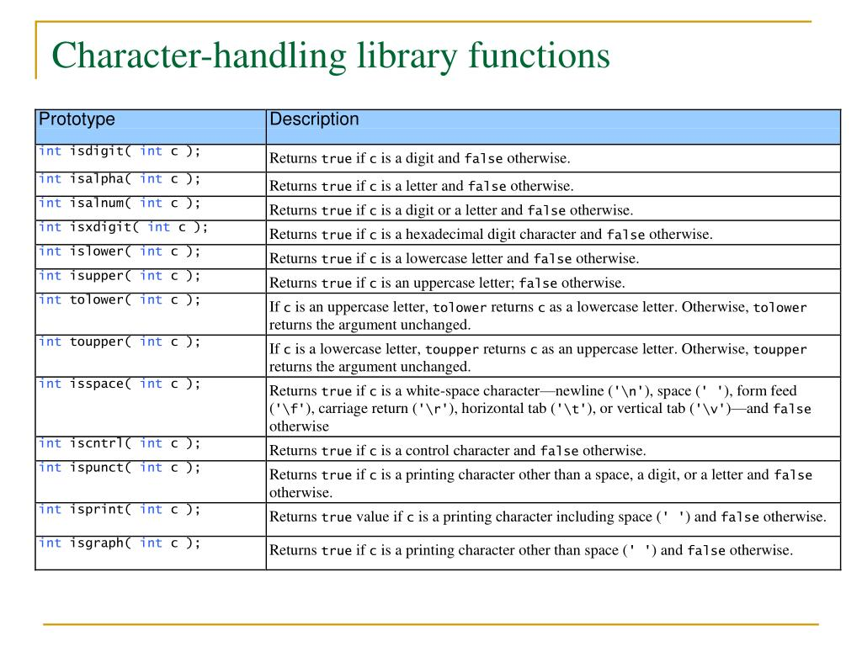
CHARACTER FUNCTIONS IN <ctype.h> where c is the character argument

Slide 39
EXAMPLE PROGRAMS USING CHARACTER FUNCTIONS:
1. ‘toupper( )’ function 2. ‘tolower( )’ function
#include <stdio.h>
#include <ctype.h>
int main() {
char str[100];
printf(“Enter a string: “ );
fgets(str, sizeof(str), stdin);
for(int i=0; str[i] != ‘\0’; i++) {
str[i] = toupper(sttr[i]);
}
printf(“Uppercase string: %s\n”,str);
return 0;
}
#include <stdio.h>
#include <ctype.h>
Int main( ) {
char str[100];
printf(“Enter a string: “);
fgets(str, sizeof(str), stdin);
for( int i=0; str[i] != ‘\0’; i++) {
str[i] = tolower(str[i]);
}
printf(“Lowercase string: %s\n”, str);
return 0;
}
OUTPUT:
Enter a string: welcome
Uppercase string: WELCOME
OUTPUT:
Enter a string: WELCOME
Lowercase string: welcome

Slide 40
To check if a character is a digit using ‘isdigit()’ function
#include<stdio.h>
#include<ctype.h>
int main( ) {
char str[100];
printf(“Enter a string: “);
fgets(str, sizeof(str), stdin);
for (int i = 0 ; str[i] != ‘\0’ ; i++) {
if (isdigit(str[i])) {
printf(“ ‘%c’ is a digit.\n”, str[i]);
} else {
printf(“ ‘%c’ is not a digit.\n”, str[i]);
}
}
return 0;
}
OUTPUT:
Enter a string: welcome10
'w' is not a digit.
'e' is not a digit.
'l' is not a digit.
'c' is not a digit.
'o' is not a digit.
'm' is not a digit.
'e' is not a digit.
'1' is a digit.
'0' is a digit.
'
' is not a digit.

Slide 41
PROGRAM TO REMOVE WHITESPACE FROM A STRING
#include <stdio.h>
#include <ctype.h>
int main( ) {
char str[100] , new_str[100];
int j = 0;
printf(“Enter a string: “);
fgets(str, sizeof(str), stdin);
for ( int i=0; str[i] != ‘\0’; i++) {
if (!isspace(str[i])) {
new_str[j++] = str[i];
}
}
new_str[j] = ‘\0’;
printf(“String without whitespace: %s\n”, new_str);
return 0;
}
OUTPUT:
Enter a string: welcome to C class
String without whitespace: welcometoCclass

Slide 42
PROGRAM TO COUNT THE NUMBER OF VOWELS AND CONSONANTS IN A GIVEN STRING
#include <stdio.h>
#include <ctype.h>
int main( ) {
char str[100] ;
int vowels=0, consonants = 0;
printf(“Enter a string:”);
fgets(str, sizeof(str), stdin);
for (int i=0; str[i] != ‘\0’; i++) {
if (isalpha(str[i])) {
char lower = tolower(str[i]);
if (lower == ‘a’ || lower == ‘e’ || lower == ‘i’ || lower == ‘o’|| lower == ‘u’ ){
vowels++;
} else {
consonants++;
}
}
}
printf(“Vowels: %d, Consonants: %d\n”, vowels, consonants);
return 0;
}
OUTPUT:
Enter a string: welcome to c class
Vowels: 5, Consonants: 10

Slide 43
STRING MANIPULATION:
If s1 and s2 are strings, a program cannot
Assign one to the other. s1=s2;
Compare them for collating sequence: s1<s2
Concatenate them to form a single longer string : s1 + s2
Return a string as the result of a function
A set of standard C library functions that are contained in <string.h> provides limited support for the first three.
The string header, string.h, provides many functions useful for manipulating strings or character arrays.

Slide 44
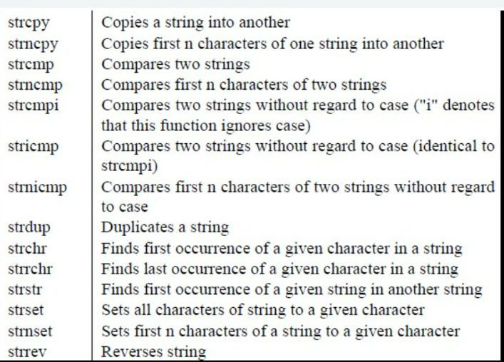
STRING MANIPULATION FUNCTIONS

Slide 45
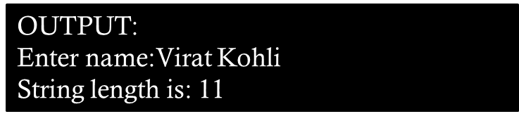
EXAMPLES:
1. Program to find the 2. Program to find the length of a string without using
length of a string using strlen: strlen:
#include <string.h>
int main( )
{
int count = 0, i;
char name[30];
printf(“Enter name:”);
gets(name);
while (name[i]!=‘\0’)
{
count++;
i++;
}
printf(“%d”,count);
}
# include <string.h>
int main( )
{
int count = 0;
char name[30];
printf(“Enter name:”);
gets(name);
count = strlen(name);
printf(“String length is: %d”,count);
}
OUTPUT:
Enter name:Virat Kohli
String length is: 11

Slide 46
PROGRAM TO CONCATENATE TWO STRINGS USING ‘strcat’
#include <stdio.h>
#include <string.h>
int main( ) {
char str1[200], str2[100];
printf(“Enter the first string: “);
fgets(str1, sizeof(str1), stdin);
printf(“Enter the second string: “);
fgets(str, sizeof(str2), stdin);
//Remove the newline character at the end of the strings if present
if (str1[strlen(str1) – 1] == ‘\n’) {
str1[strlen(str1) – 1] = ‘\0’;
}
if (str2[strlen(str2) – 1] ==‘\n’) {
str2[strlen(str2) – 1] = ‘\0’ ;
}
strcat(str1, str2);
printf(“Concatenated string: %s\n”, str1);
return 0;
}
OUTPUT:
Enter the first string: welcome
Enter the second string: everyone
Concatenated string: welcomeeveryone

Slide 47
PROGRAM TO CONCATENATE TWO STRINGS WITHOUT USING strcat()
#include <string.h>
int main( )
{
int len1, len2;
char s1[30] = “WELCOME”;
char s2[30] = “EVERYONE”;
len1 = strlen(s1);
len2 = strlen(s2);
for(i=0; i<=len2; i++)
{
s1[len1 + i] = s2[i];
}
printf(“%s”, s1);
}
OUTPUT:
WELCOMEEVERYONE

Slide 48
PROGRAM TO COMPARE TWO STRINGS:
SYNTAX:
strcmp(const char * str1 ; const char * str2);
Pointer is pointing to the string.
The content to which the pointer points is constant.
It returns unsigned int.
It returns zero when both are same.
It compares the ascii values of characters.
When the ascii value of first character of the first string is larger, then it gives positive value.
When the ascii value of first character of the first string is smaller, then it gives negative value.

Slide 49
PROGRAM TO COMPARE TWO PROGRAM TO COMPARE TWO STRINGS
STRINGS USING strcmp: WITHOUT USING strcmp:
#include <stdio.h>
#include <string.h>
Void main( ){
int flag=0;
char s1[] = “HELLO”;
char s2[] = “HI”;
for(int i=0; s1[i]!=‘\0’ || s2[i]!=‘\0’, i++){
if(s1[i] != s2[i]){ 0 1 2 3 4 5
flag = 1; s1
break;
}
} 0 1 2
if (flag == 1){ s2
printf(“Not same”);
}
}
#include <stdio.h>
#include <string.h>
void main( )
{
int value;
char s1[] = “HELLO”;
char s2[] = “WELCOME”;
value = strcmp(s1, s2);
if (value == 0)
printf(“SAME”);
else
printf(“NOT SAME”);
printf(“\n%d”,value);
}
H | E | L | L | O | \0
1000
1000 1001 1002 1003 1004 1005
H | I | \0
2000 2001 2002
OUTPUT:
NOT SAME
-15
OUTPUT:
Not same

Slide 50
PROGRAM TO REVERSE A STRING CORRECTED ONE
This won’t work. First, ‘i’ will be stored at ‘j’s place.
Next, same ‘i’ will be stored at index 6. ‘j’ is lost then.
We need a backup of it. So, initialise a variable ‘ch’.
#include <stdio.h>
#include <string.h>
void main ()
{
char s1[30] = “WELCOME”;
l = strlen(s1);
for (int i = 0; i<l/2; i++)
{
s1[i] = s1[l – 1 - i];
s1[l – 1 – i] = s1[i];
}
}
#include <stdio.h>
#include <string.h>
void main(){
int l ,i;
char ch;
char s1[30] = “WELCOME”;
l = strlen(s1);
for(int i=0; i<l/2; i++){
ch=s1[i];
s1[i] = s1[l – 1 – i];
s1[l – 1 – i] = ch;
}
printf(“%s”,s1);
}
OUTPUT:
EMOCLEW

